Slide 1
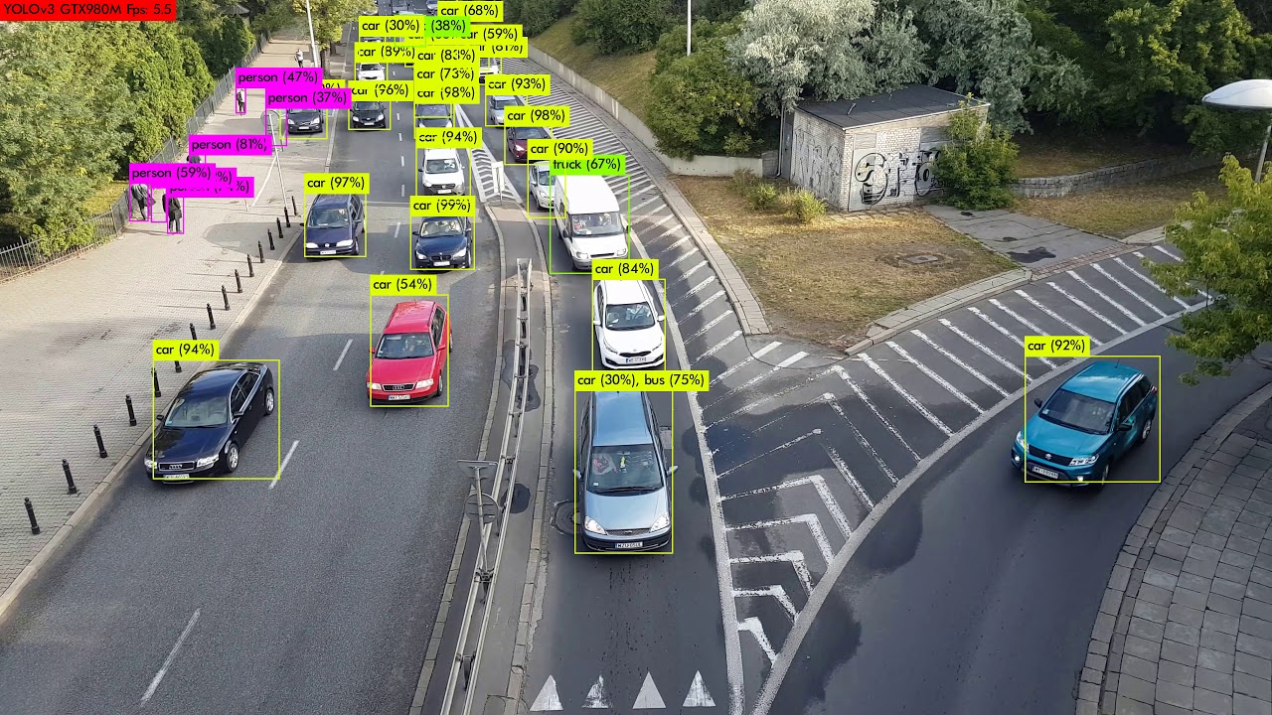
Majek, K. (2018, June 28). 4K traffic cam analysis with yolov3 PART1 - object detection. YouTube. Retrieved April 17, 2023, from https://www.youtube.com/watch?v=lekdUXv82xQ&ab_channel=KarolMajek
An Exploration Into Object Detection And Application in Traffic Scene Object Detection
-- Minh Duc Dao --

Slide 2
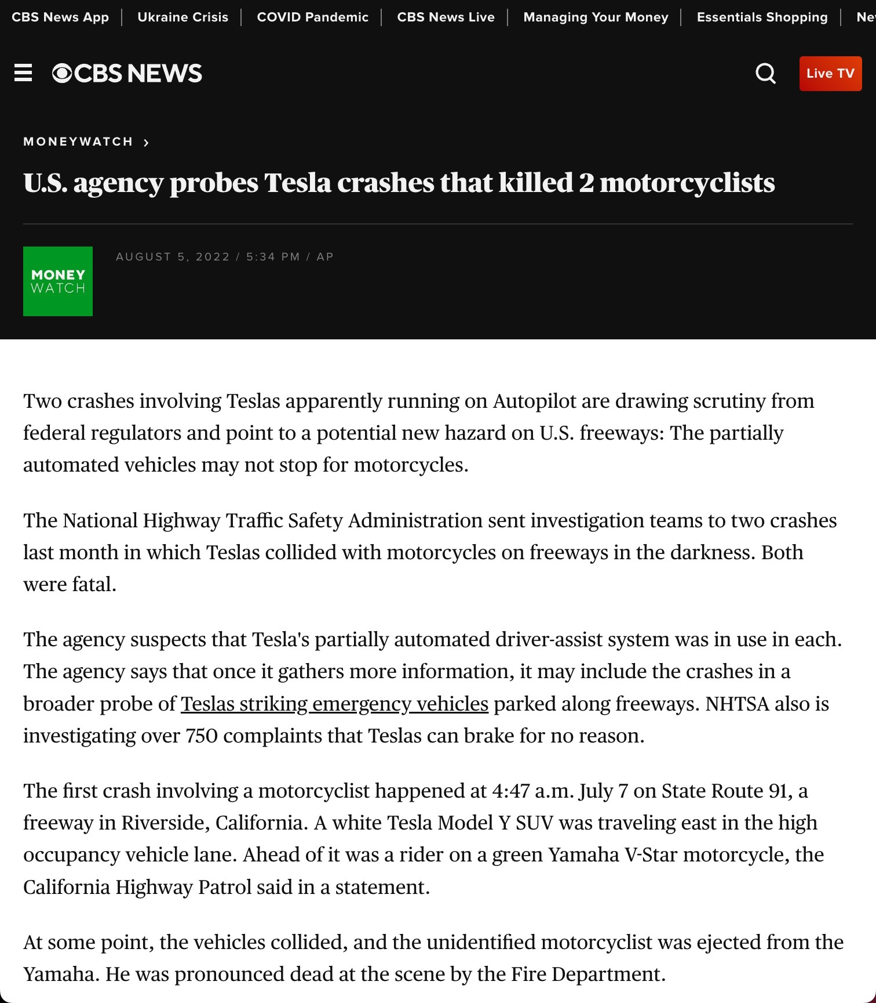
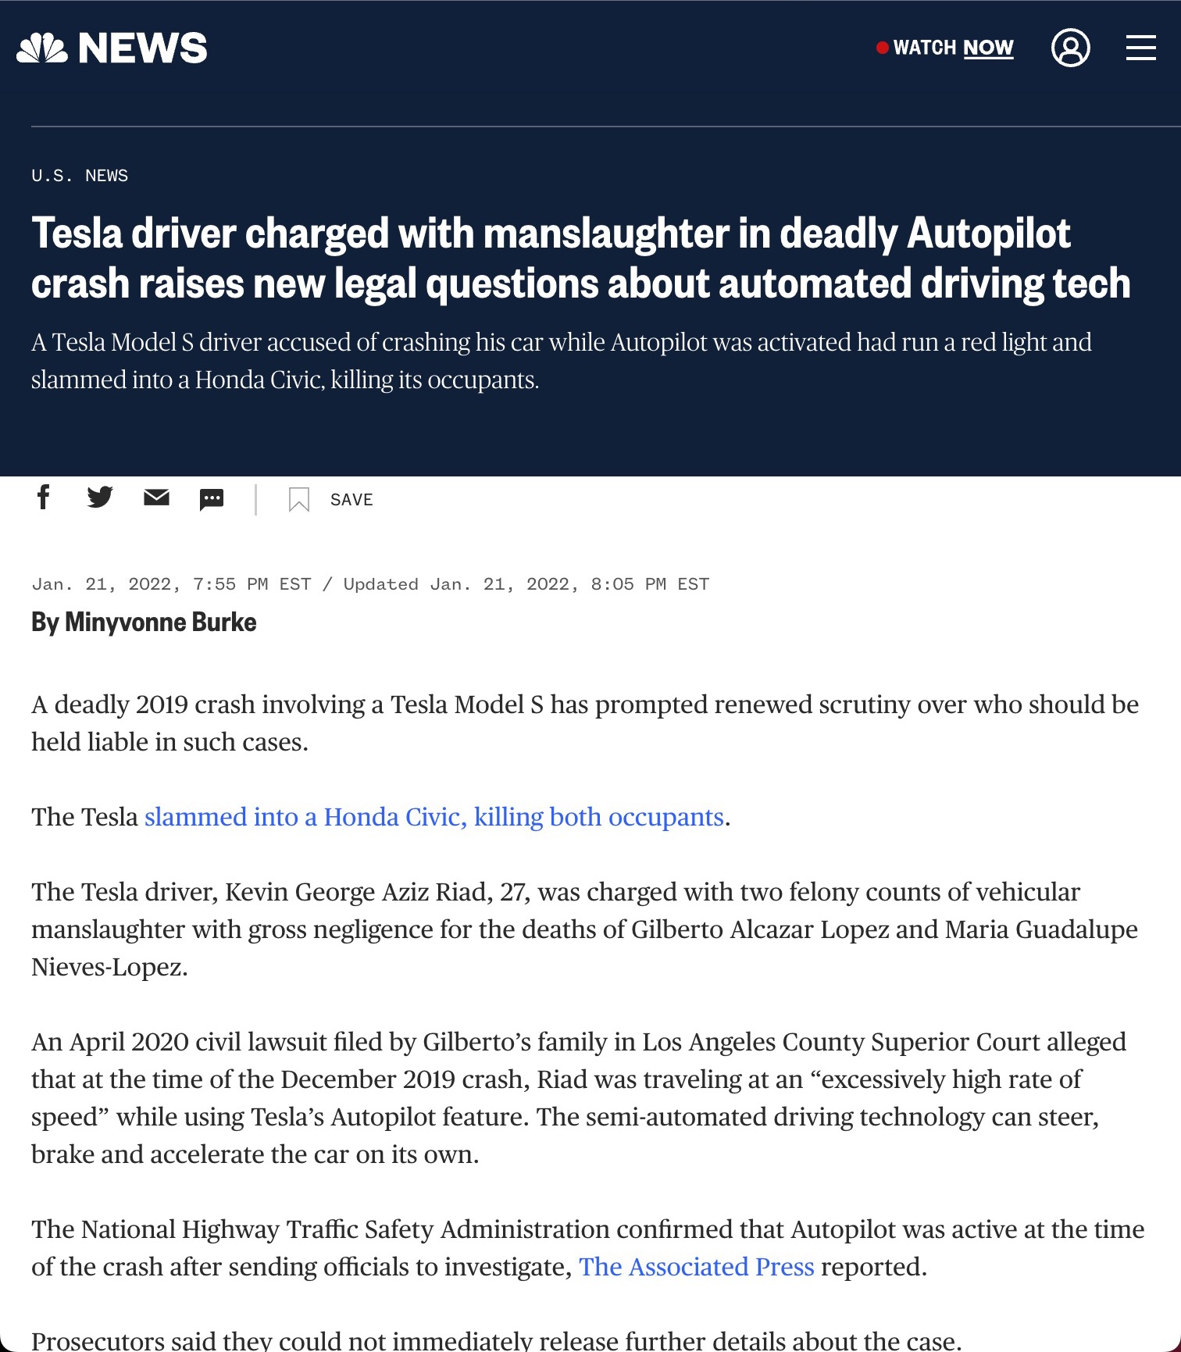
Introduction
July 2022: 2 incidents, 2 motorcyclists dead
2019: crash another car, 2 people dead
273 incidents in 2019

Slide 3
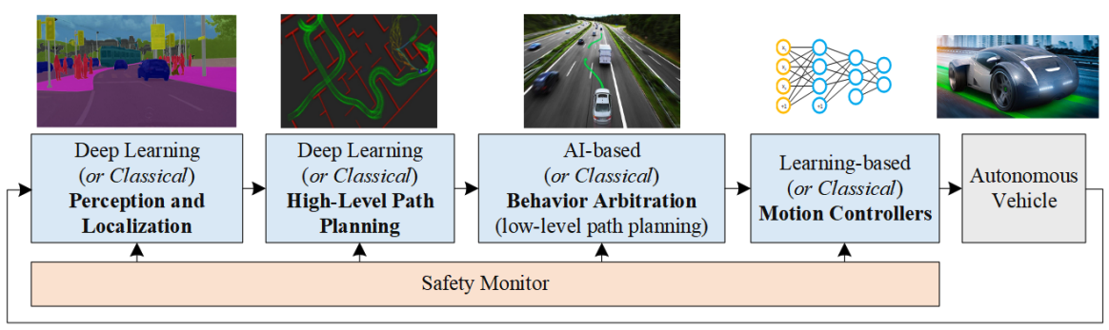
Hypothesis
Video segmentation at Perception and Localization step fail…
Grigorescu, S., Trasnea, B., Cocias, T., & Macesanu, G. (2020). A survey of deep learning techniques for autonomous driving. Journal of Field Robotics, 37(3), 362-386.ç

Slide 4
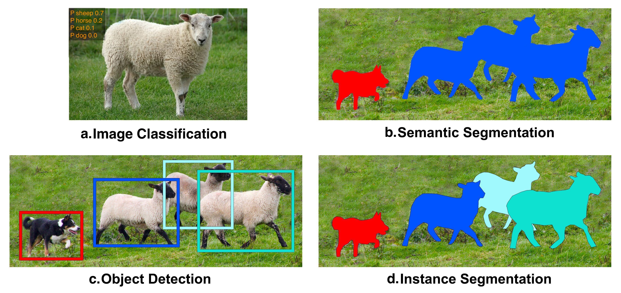
Computer Vision Tasks
Robotic manipulation. Ch. 9 - Object Detection and Segmentation. (n.d.). Retrieved April 15, 2023, from https://manipulation.csail.mit.edu/segmentation.html
Notes:
- Discuss different task
- state the focus of this study is in object detection
- The two model family we discussed in this study are R-CNN and YOLO
- we also state an adaptation of object detection model to instance segmentation (Mask R-CNN)

Slide 5
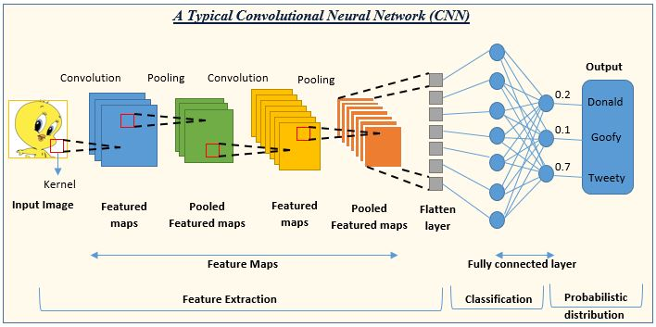
Convolution Neural Network (CNN)
Convolutional, Pooling, and Fully Connected Layers
Shah, S. (2022, March 15). Convolutional Neural Network: An overview. Analytics Vidhya. Retrieved April 15, 2023, from https://www.analyticsvidhya.com/blog/2022/01/convolutional-neural-network-an-overview/

Slide 6
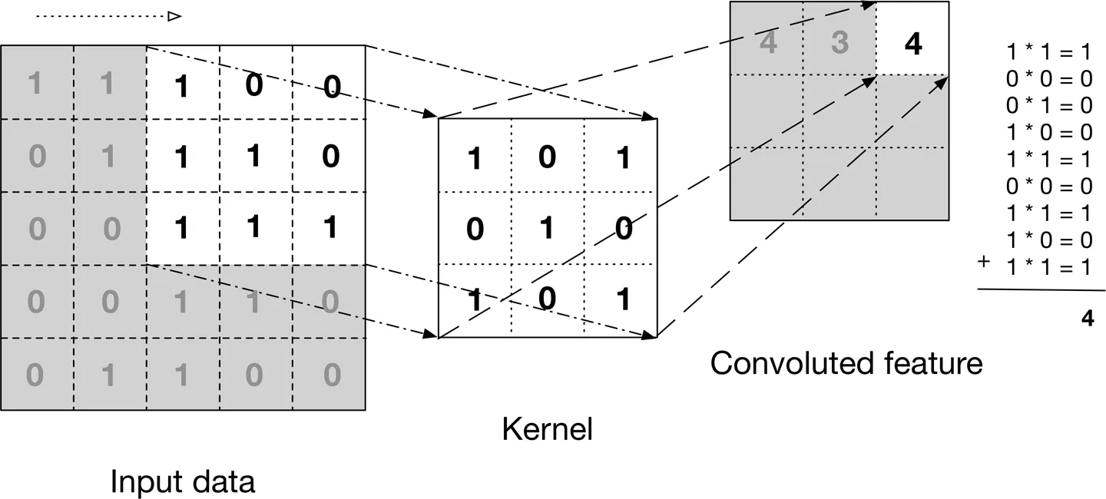
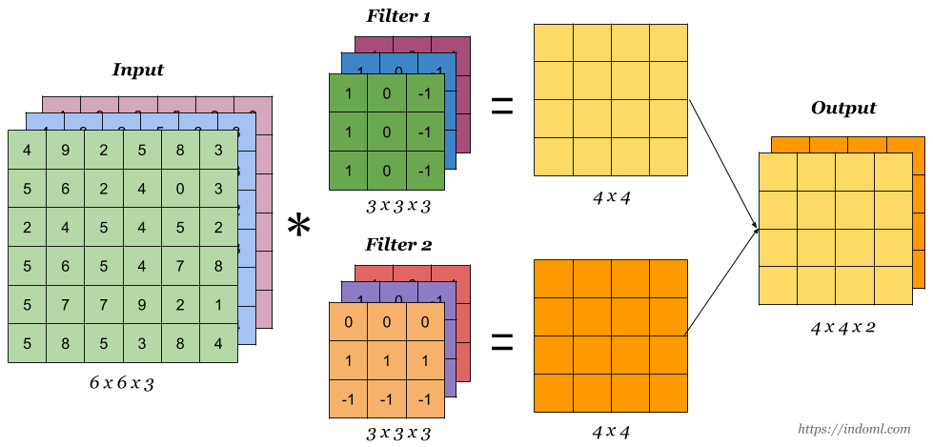
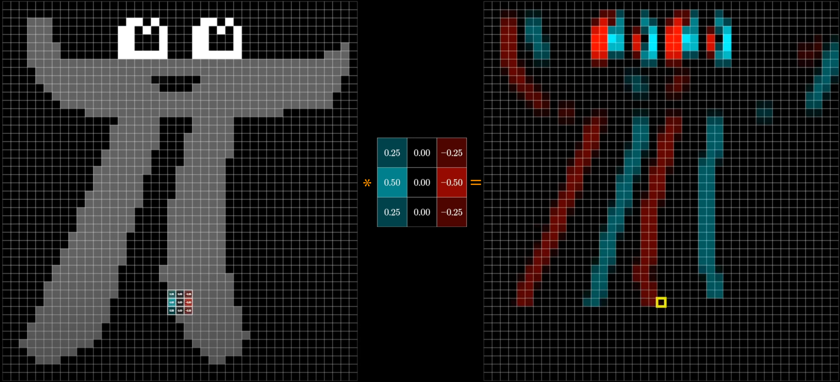
Convolutional Layer
Used to extract features
Predefined or learned
Stack feature map along the depth
Yin, L. (2019, January 5). A summary of neural network layers. Medium. Retrieved April 15, 2023, from https://medium.com/machine-learning-for-li/different-convolutional-layers-43dc146f4d0e
Ng, A. (n.d.). Convolutional Neural Networks. Coursera. Retrieved April 15, 2023, from https://www.coursera.org/learn/convolutional-neural-networks
3Blue1Brown. (2022, November 18). But what is a convolution? YouTube. Retrieved April 6, 2023, from https://www.youtube.com/watch?v=KuXjwB4LzSA&amp;t=1184s&amp;ab_channel=3Blue1Brown

Slide 7
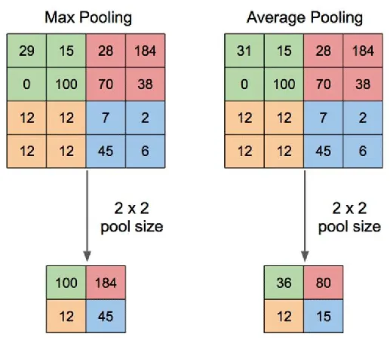
Pooling Layer
Reduce number of neurons
Reduce network complexity
Most common:
max-pool
average-pool
Rajput, V. (2022, December 22). Pooling Layers in neural nets and their variants. Medium. Retrieved April 15, 2023, from https://medium.com/aiguys/pooling-layers-in-neural-nets-and-their-variants-f6129fc4628b

Slide 8
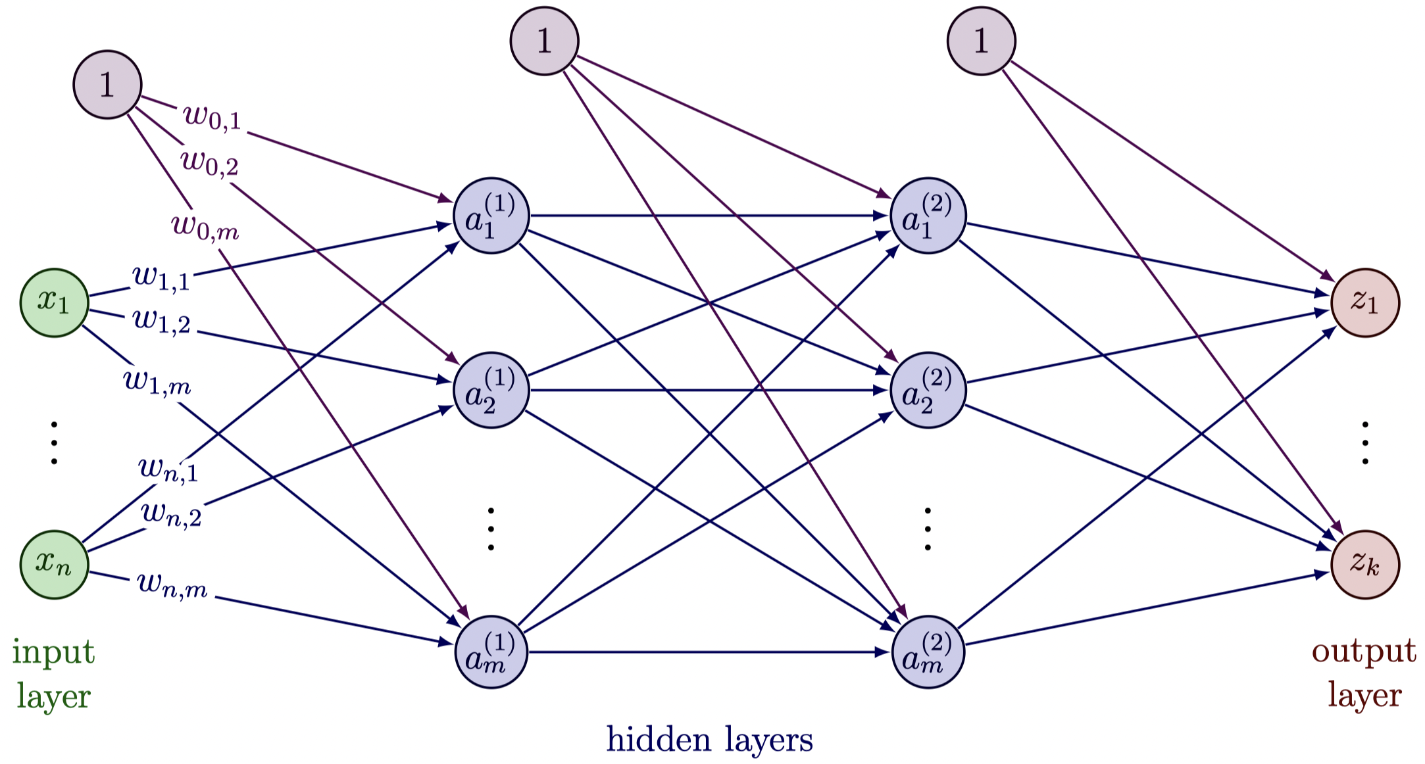

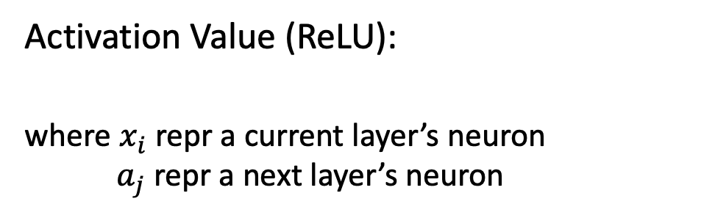
Fully connected neural network
(Forward)
Activation Value (ReLU):
where $x_{i}$ repr a current layer’s neuron
$a_{j}$ repr a next layer’s neuron
Nabiyev, N. (n.d.). Figure 5:Working Principles of Softmax Function - Researchgate. ResearchGate. Retrieved April 15, 2023, from https://www.researchgate.net/figure/Working-principles-of-softmax-function_fig3_349662206

Slide 9
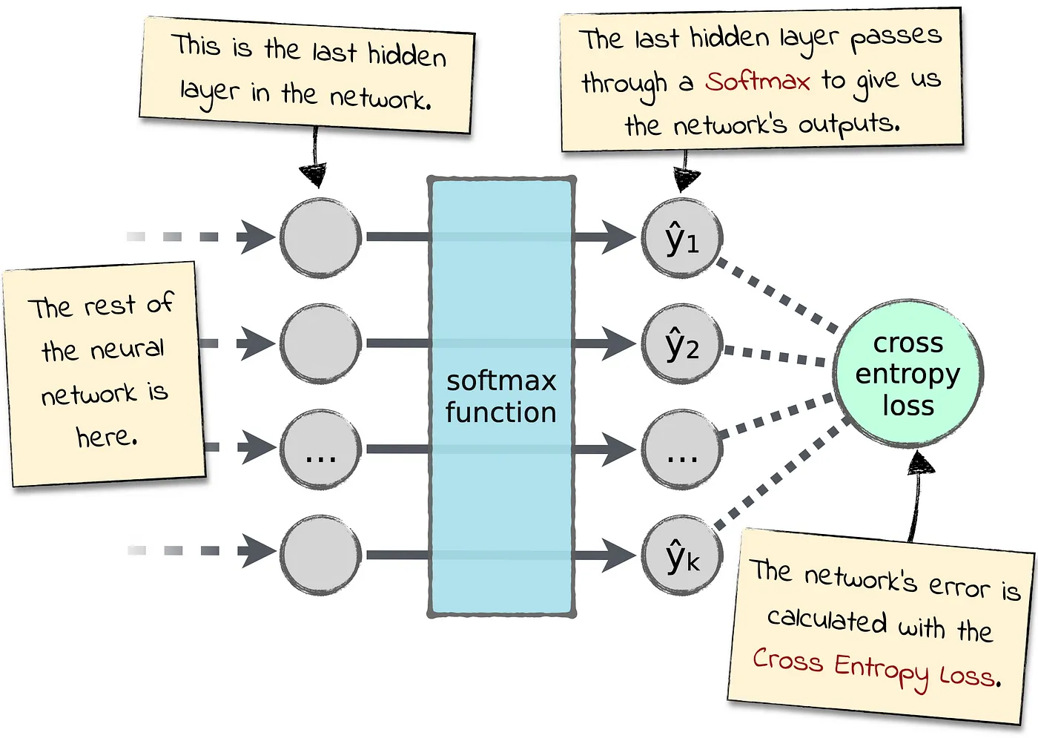
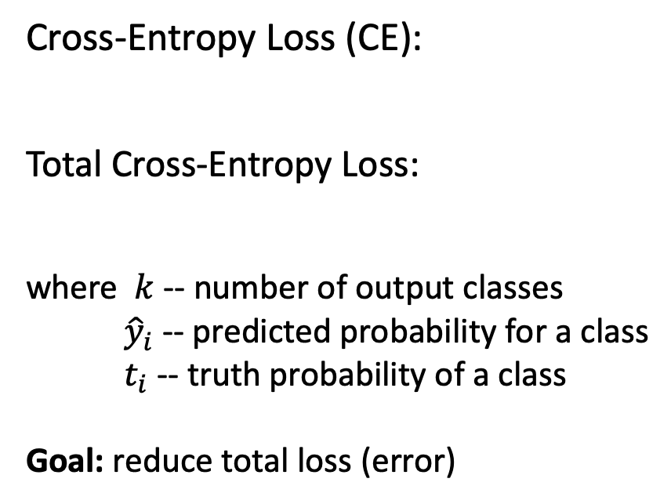
Fully connected neural network (Evaluation)
Cross-Entropy Loss (CE):
Total Cross-Entropy Loss:
where $k$ -- number of output classes
${\hat{y}}_{i}$ -- predicted probability for a class
$t_{i}$ -- truth probability of a class
Goal: reduce total loss (error)
Perrotta, P. (2021, March 15). Killer combo: Softmax and Cross Entropy. Medium. Retrieved April 15, 2023, from https://levelup.gitconnected.com/killer-combo-softmax-and-cross-entropy-5907442f60ba

Slide 10
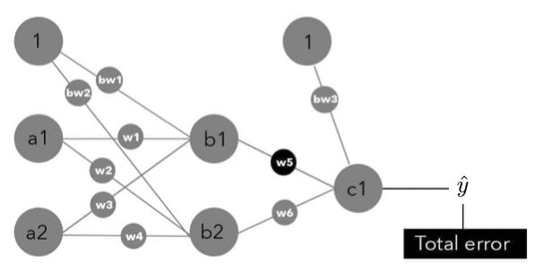
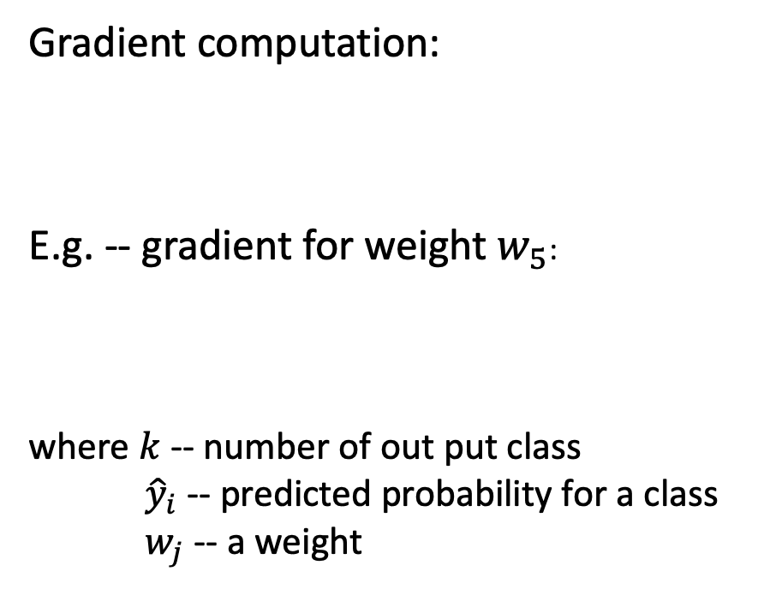
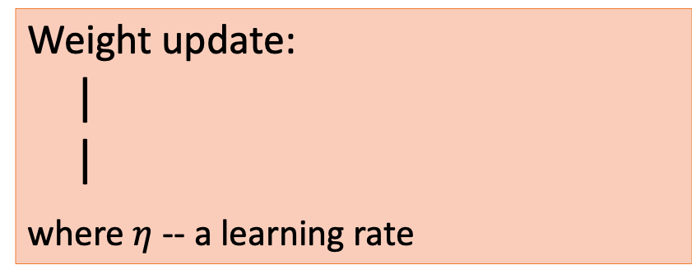
Fully connected neural network (Learning)
Gradient computation:
E.g. -- gradient for weight $w_{5}$:
where $k$ -- number of out put class
${\hat{y}}_{i}$ -- predicted probability for a class
$w_{j}$ -- a weight
Weight update:
|
|
where $η$ -- a learning rate
Taylor, M. (2017). Neural Networks: A visual introduction for beginners. Blue Windmill Media.

Slide 11
Regional-based CNN (R-CNN) Family
R-CNN, Fast R-CNN, Faster R-CNN, and Mask R-CNN

Slide 12
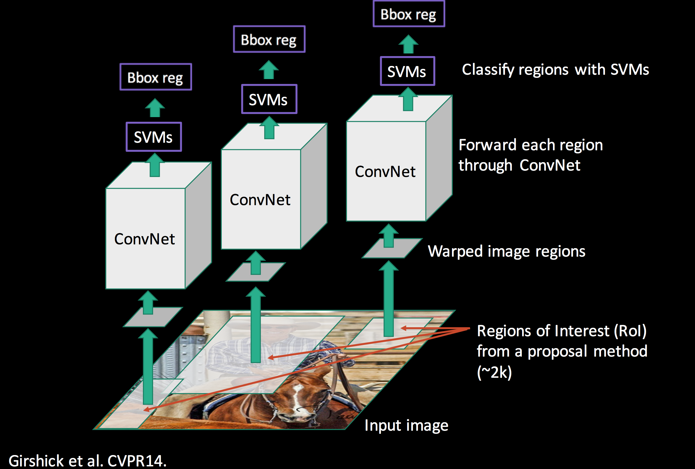
R-CNN
Selective Search – group pixels:
Color similarity
Texture similarity
Fill similarity
Size similarity
Each RoI as individual image
RoI’s feature extraction
Support vector machines (SVMs)
1 bounding box regressor and 1 SVMs per class (output neuron)
Multi-stage training
Reported runtime: 47s/image
Sharma, P. (2020, May 24). A step-by-step introduction to the Basic Object Detection Algorithms (part 1). Analytics Vidhya. Retrieved April 15, 2023, from https://www.analyticsvidhya.com/blog/2018/10/a-step-by-step-introduction-to-the-basic-object-detection-algorithms-part-1/

Slide 13
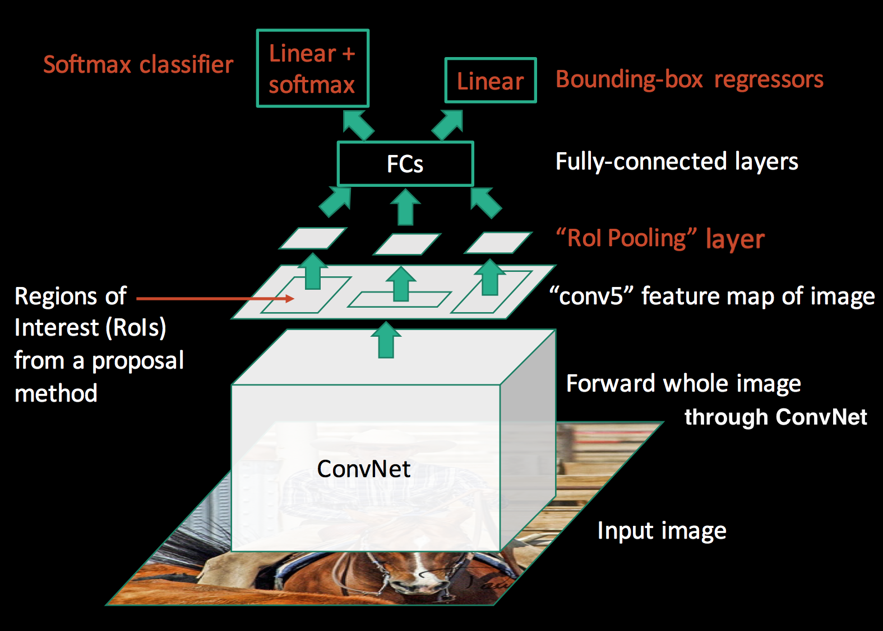
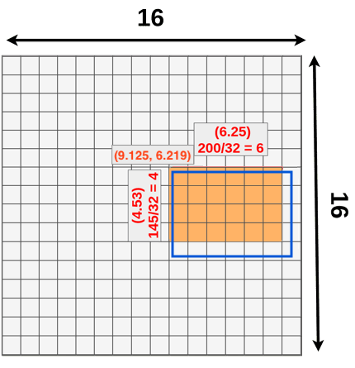
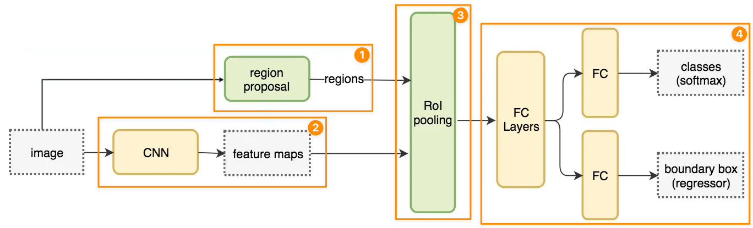
Fast R-CNN
Image’s feature extraction
RoI pooling layer:
Project RoI onto feature map
Suffer quantization issue
One stage training
Reported runtime: 2.3s/image
Sharma, P. (2020, May 24). A step-by-step introduction to the Basic Object Detection Algorithms (part 1). Analytics Vidhya. Retrieved April 15, 2023, from https://www.analyticsvidhya.com/blog/2018/10/a-step-by-step-introduction-to-the-basic-object-detection-algorithms-part-1/
Hui, J. (2019, February 22). What do we learn from region based object detectors (faster R-CNN, R-FCN, FPN)? Medium. Retrieved April 15, 2023, from https://jonathan-hui.medium.com/what-do-we-learn-from-region-based-object-detectors-faster-r-cnn-r-fcn-fpn-7e354377a7c9

Slide 14
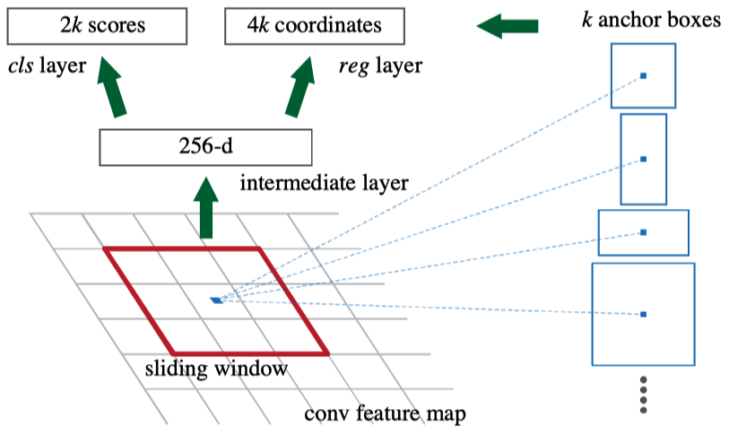
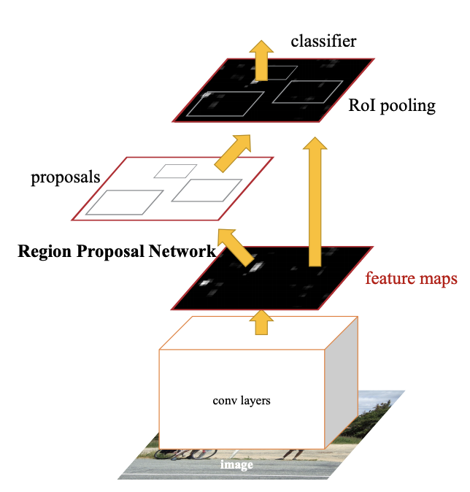
Faster R-CNN
Replace Selective Search with RPN
Region Proposal Network (RPN)
RPN generate 9 RoIs from feature map
3 different scale
3 different aspect ratio
cls layer: give objectiveness score for RoI
reg layer: refine RoI box
Sharma, P. (2020, May 24). A step-by-step introduction to the Basic Object Detection Algorithms (part 1). Analytics Vidhya. Retrieved April 15, 2023, from https://www.analyticsvidhya.com/blog/2018/10/a-step-by-step-introduction-to-the-basic-object-detection-algorithms-part-1/

Slide 15
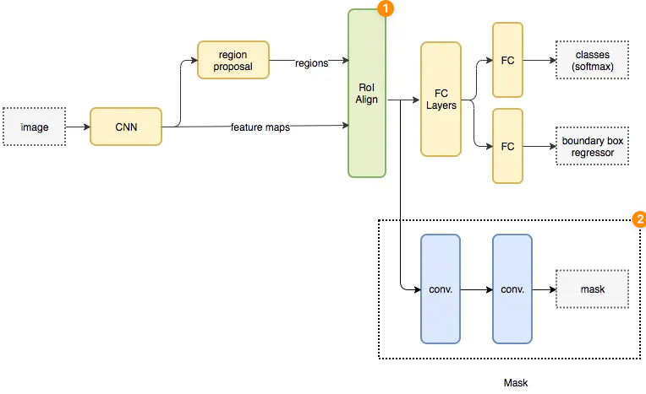
Mask R-CNN (Architecture)
Architecture based on Faster R-CNN
Replace RoIPool with RoIAlign
Add the mask branch
Hui, J. (2022, September 6). Image segmentation with mask R-CNN. Medium. Retrieved April 16, 2023, from https://jonathan-hui.medium.com/image-segmentation-with-mask-r-cnn-ebe6d793272

Slide 16
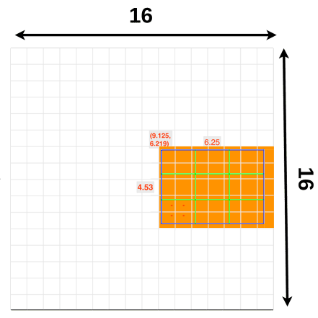
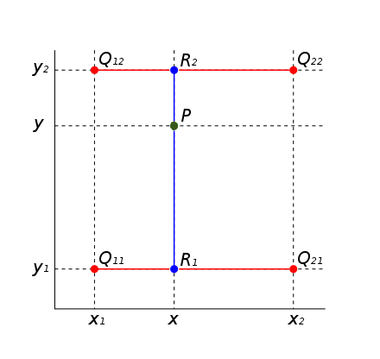
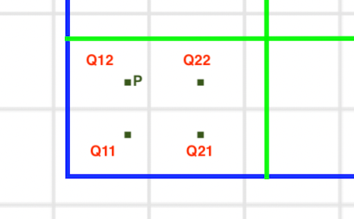
Mask R-CNN (RoIAlign)
No quantization
At each RoI bin:
perform max-pool on interpolated value
Use bilinear interpolation:
E.g.:
Swienegel. (2023, March 30). Bilinear interpolation. Wikipedia. Retrieved April 16, 2023, from https://en.wikipedia.org/wiki/Bilinear_interpolation#/media/File:BilinearInterpolationV2.svg

Slide 17
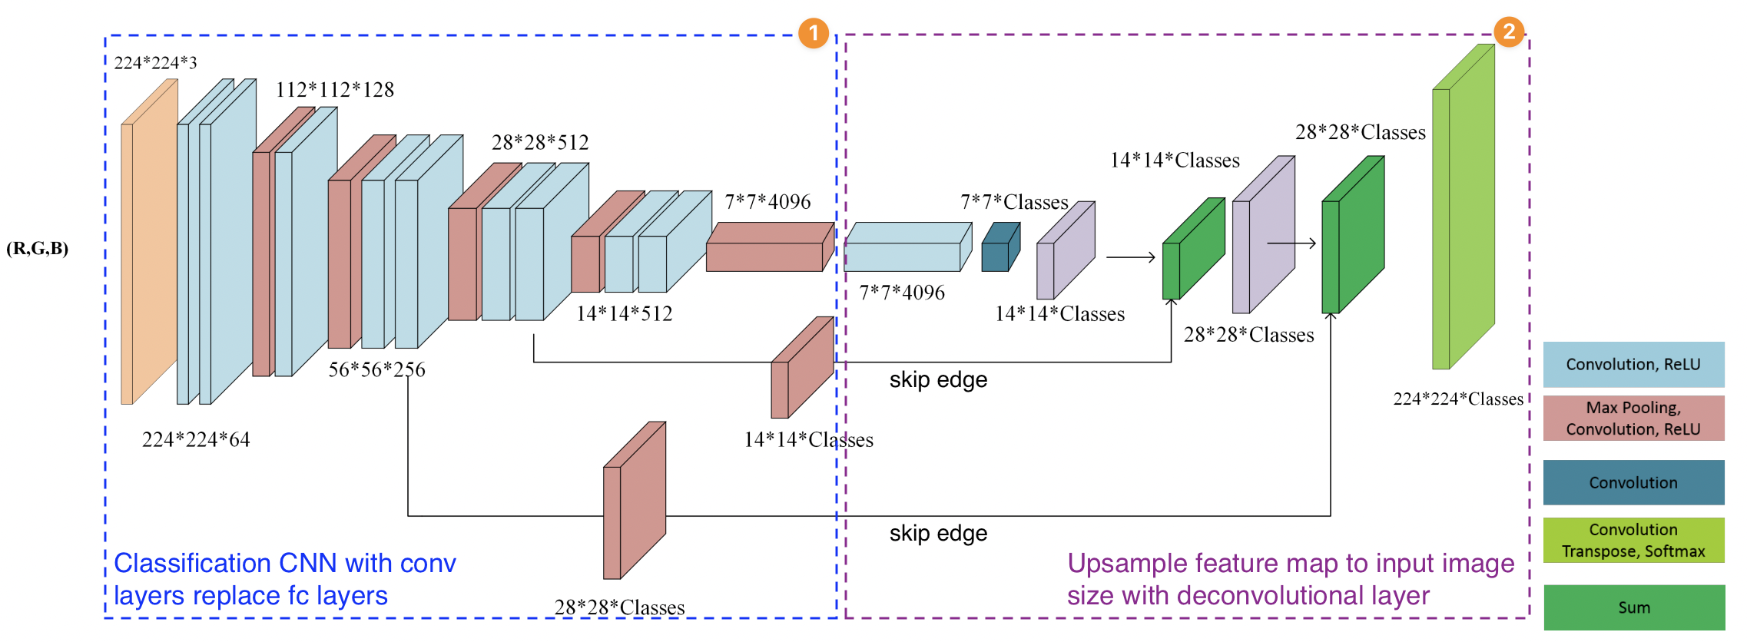
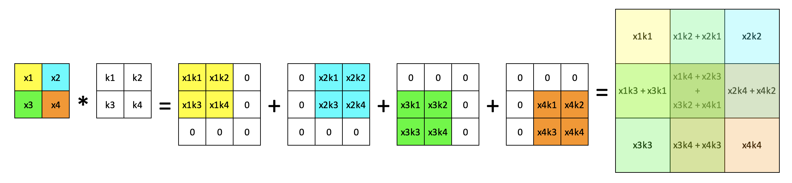
Mask R-CNN (Mask Branch)
Decoder of an FCN
Use conv layer for classification
Preserve pixels spatial information
Upsampling with learnable kernel
Use skip connection:
Improve mask’s correctness
Piramanayagam, S., Wade, S., Frederick, K., &amp; Eli, S. (n.d.). Fully Convolutional Neural Network Architecture (FCN-8). - researchgate. ResearchGate. Retrieved April 16, 2023, from https://www.researchgate.net/figure/Fully-convolutional-neural-network-architecture-FCN-8_fig1_327521314
Notes:
Fully convolution network
Bring detail from high-level feature map to upsampled low-level feature map

Slide 18
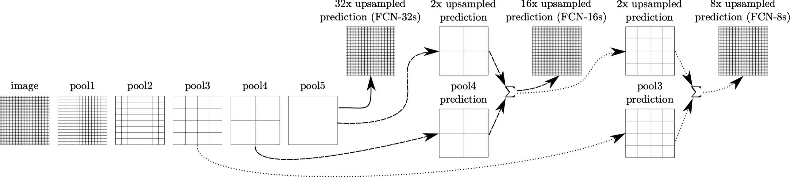
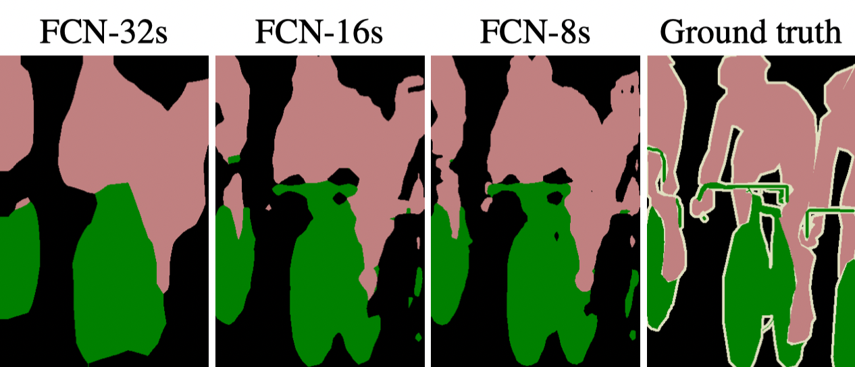
Mask R-CNN (Mask Branch 2)
He, K., Gkioxari, G., Dollár, P., & Girshick, R. (2017). Mask r-cnn. In Proceedings of the IEEE international conference on computer vision (pp. 2961-2969).

Slide 19
You Only Look Once (YOLO) Family
YOLOv1, YOLOv2 (YOLO9000), YOLOv3, and YOLOv5

Slide 20
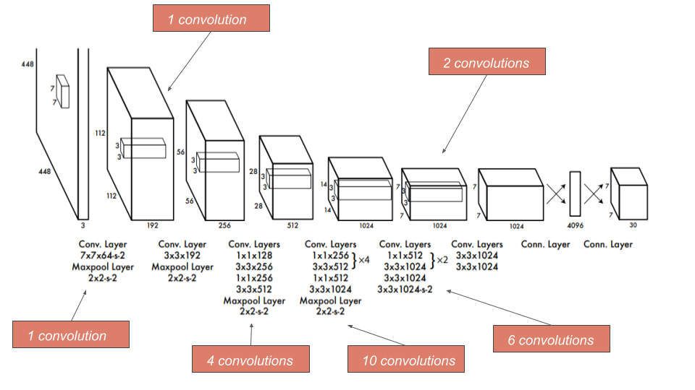
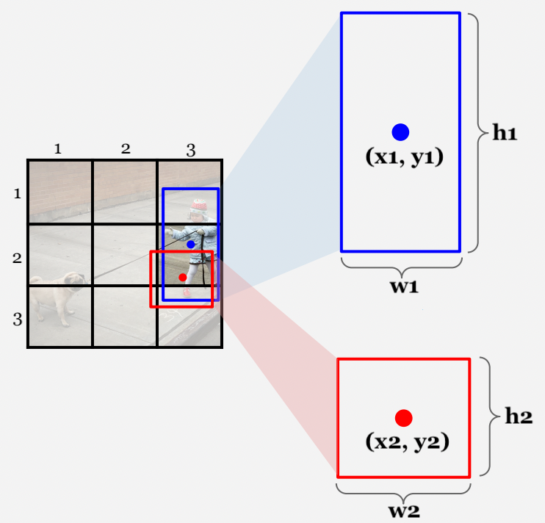
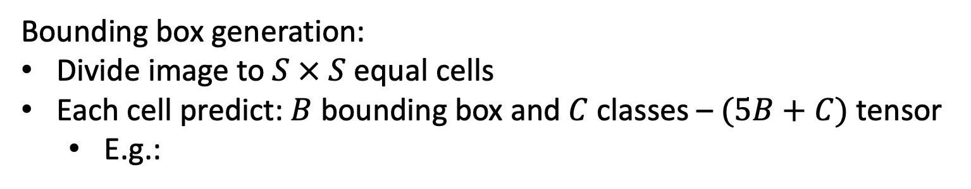
YOLOv1
Use a CNN for object detection task
24 conv layer & 2 fc layer
Use leaky ReLU:
Bounding box generation:
Divide image to $S × S$ equal cells
Each cell predict: $B$ bounding box and $C$ classes – $(5B+C)$ tensor
E.g.:
Aidouni, M. E. (2019, June 25). Understanding Yolo and yolov2. Manal El Aidouni. Retrieved April 16, 2023, from https://manalelaidouni.github.io/Understanding%20YOLO%20and%20YOLOv2.html

Slide 21
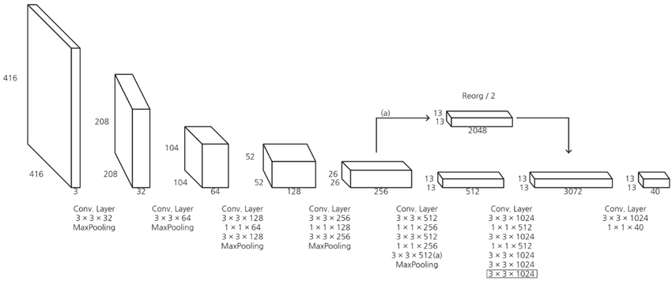
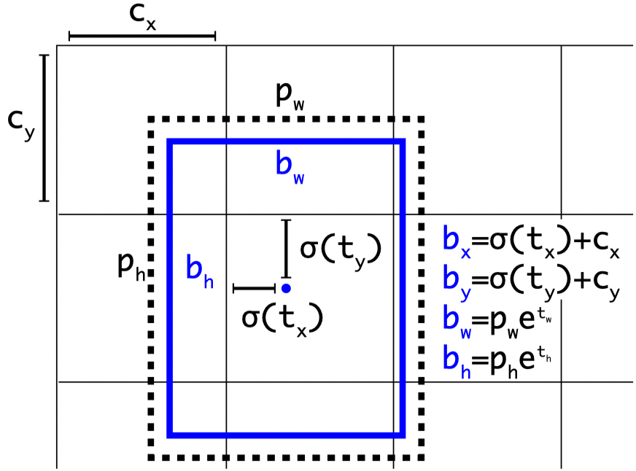
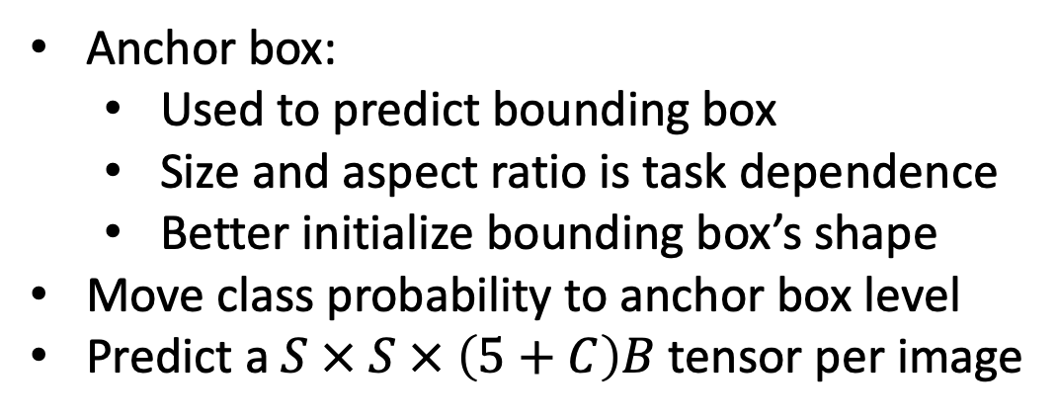
YOLOv2
Higher resolution classifier
Passthrough layer:
Improve: predict small obj
Multi-scale training
Anchor box:
Used to predict bounding box
Size and aspect ratio is task dependence
Better initialize bounding box’s shape
Move class probability to anchor box level
Predict a $S × S × \left(5+C\right)B$ tensor per image
Choi, Seong, Song, S., Yoon, J.-H., & Kim, S. Y. (n.d.). The architecture of yolov2. | download scientific diagram - researchgate. ResearchGate. Retrieved April 17, 2023, from https://www.researchgate.net/figure/The-architecture-of-YOLOv2_fig4_336177198
Redmon, J., & Farhadi, A. (2017). YOLO9000: better, faster, stronger. In Proceedings of the IEEE conference on computer vision and pattern recognition (pp. 7263-7271).

Slide 22
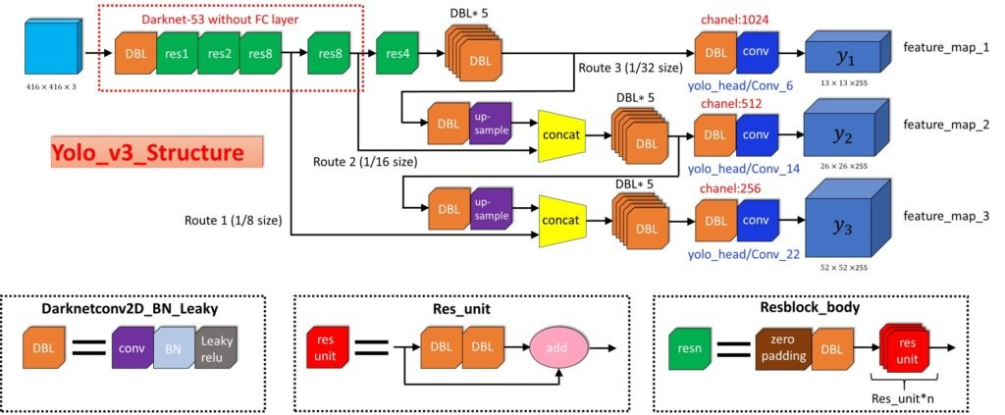
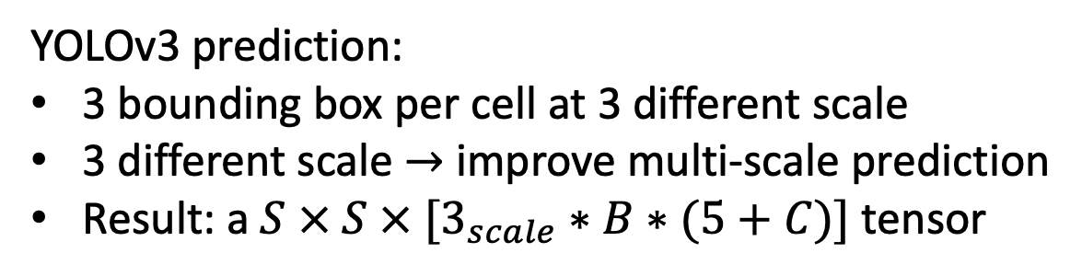
YOLOv3 and YOLOv5
YOLOv3 prediction:
3 bounding box per cell at 3 different scale
3 different scale $→$ improve multi-scale prediction
Result: a $S × S × [3_{scale}∗B∗(5+C)]$ tensor
YOLOv5:
YOLOv3 with flexible model’s size control
Further training compare to YOLOv3
Datahacker.rs, datahacker.rs. (2020, March 17). #011 TF Yolo V3 object detection in tensorflow 2.0. Master Data Science. Retrieved April 16, 2023, from https://datahacker.rs/tensorflow2-0-yolov3/

Slide 23
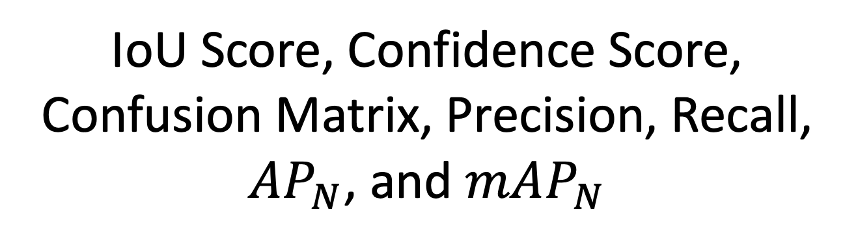
Evaluation Metrics
IoU Score, Confidence Score, Confusion Matrix, Precision, Recall, $AP_{N}$, and $mAP_{N}$

Slide 24
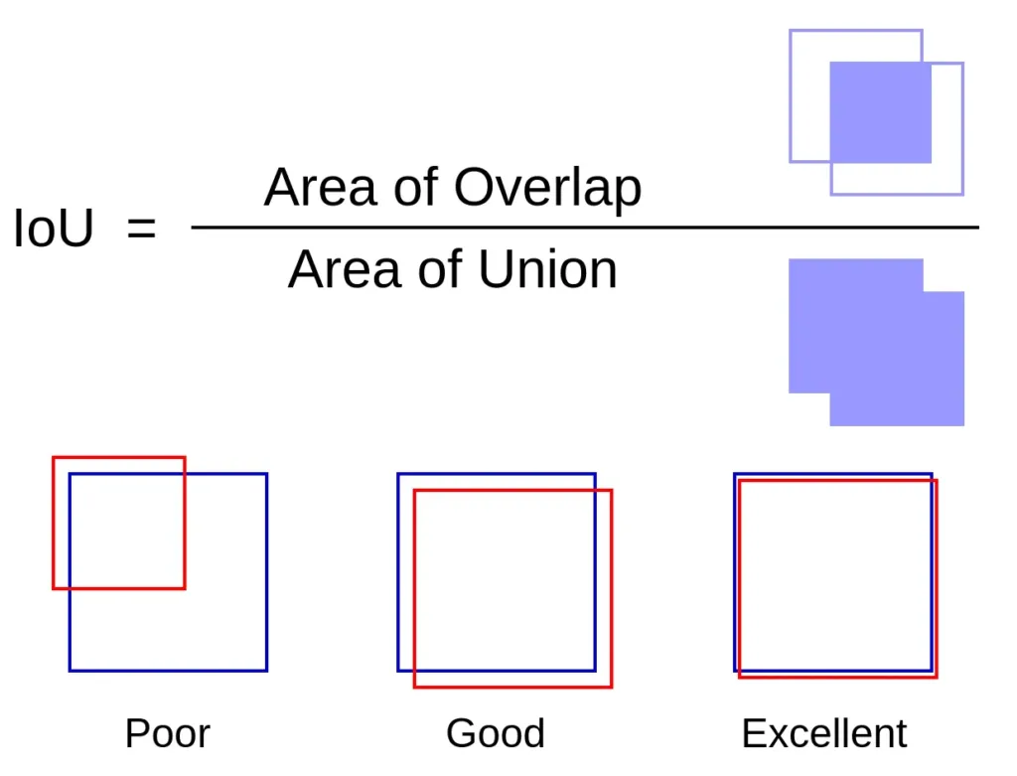
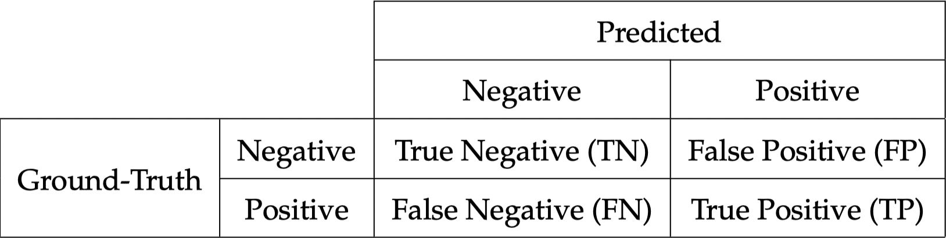
IoU Score, Confidence Score, and Confusion Matrix
IoU score: object’s location correctness
Confidence score: level of certainty
Confusion Matrix:
Tomar, N. (2023, February 8). What is intersection over union (IOU) in object detection? Idiot Developer. Retrieved April 16, 2023, from https://idiotdeveloper.com/what-is-intersection-over-union-iou/

Slide 25
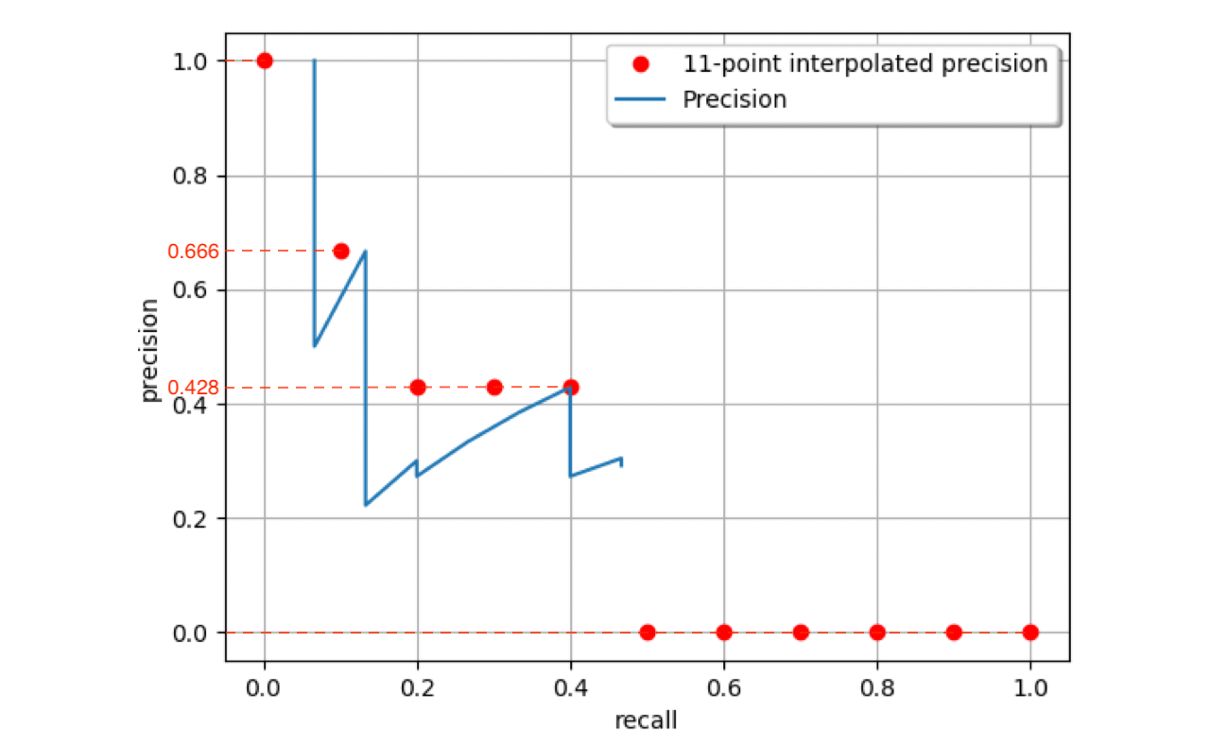
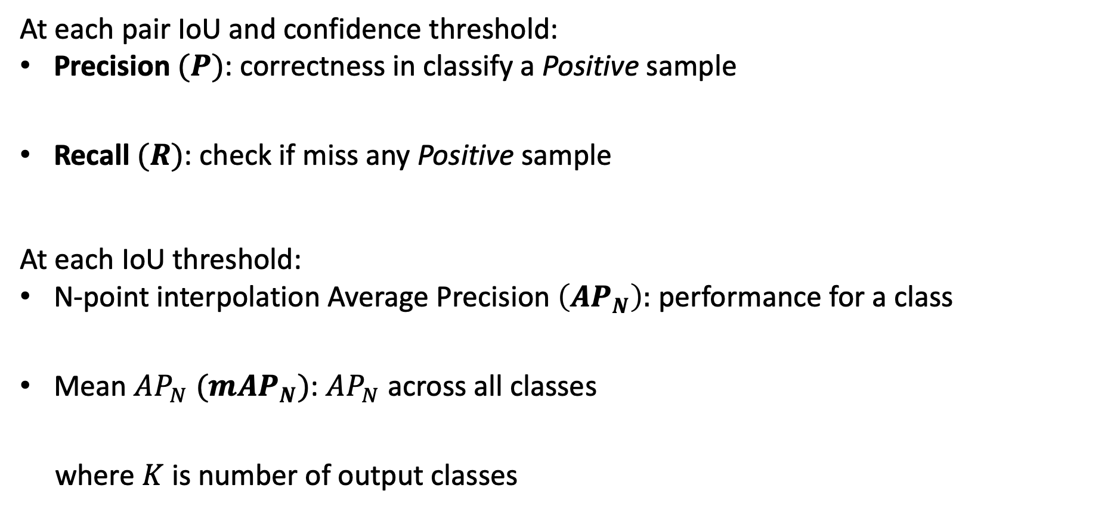
Precision, Recall, $AP_{N}$, and $mAP_{N}$
At each pair IoU and confidence threshold:
Precision $(P)$: correctness in classify a Positive sample
Recall $(R)$: check if miss any Positive sample
At each IoU threshold:
N-point interpolation Average Precision $\left(AP_{N}\right):$ performance for a class
Mean $AP_{N}$ $(mAP_{N})$: $AP_{N}$ across all classes
where $K$ is number of output classes

Slide 26
Comparison Software Demo
Compare Mask R-CNN and YOLOv5
on Traffic Scene Object Detection

Slide 27
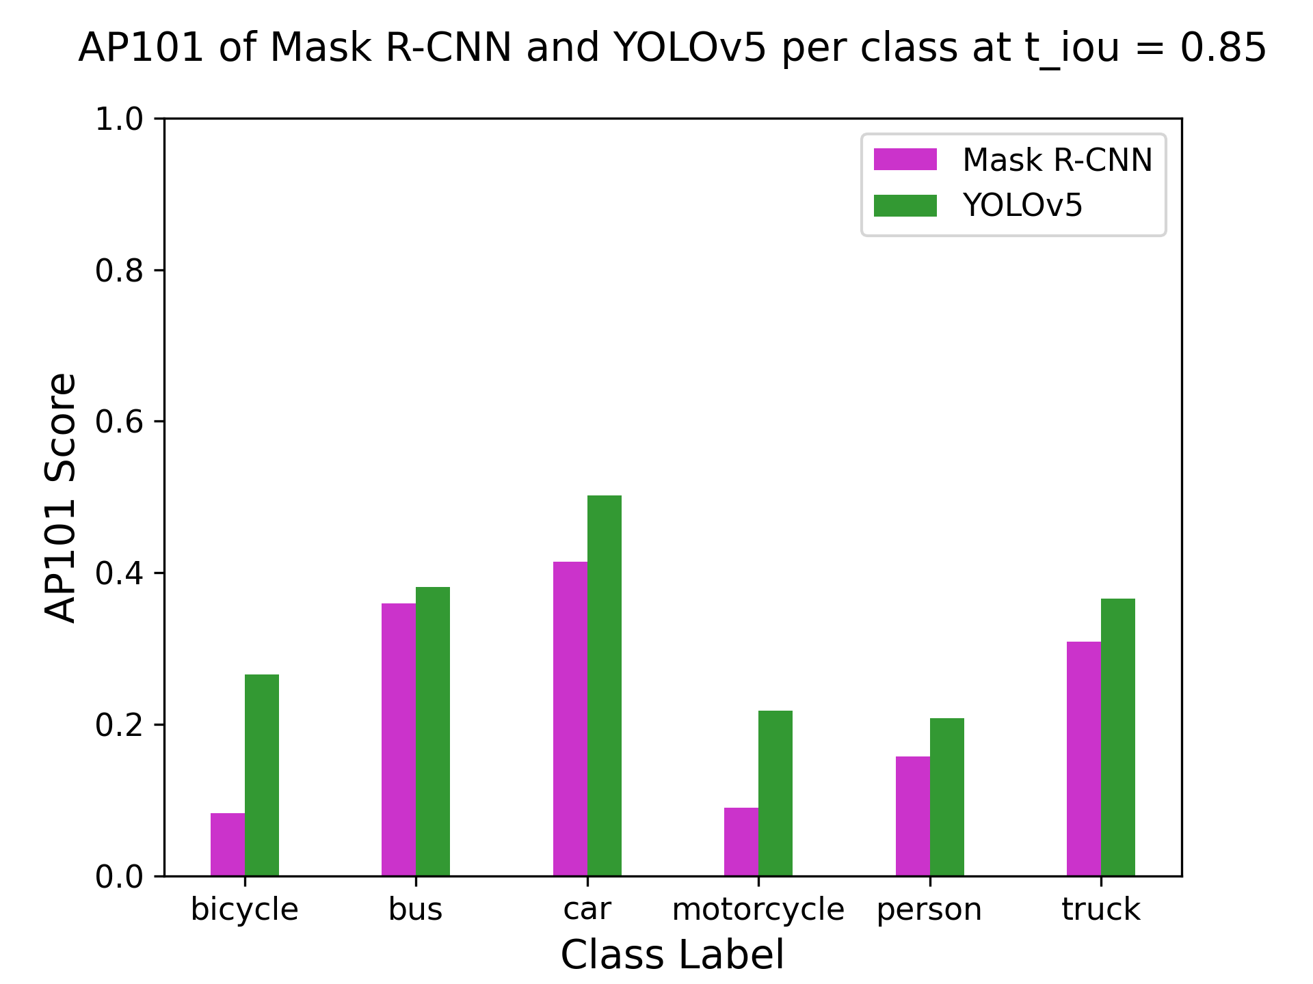
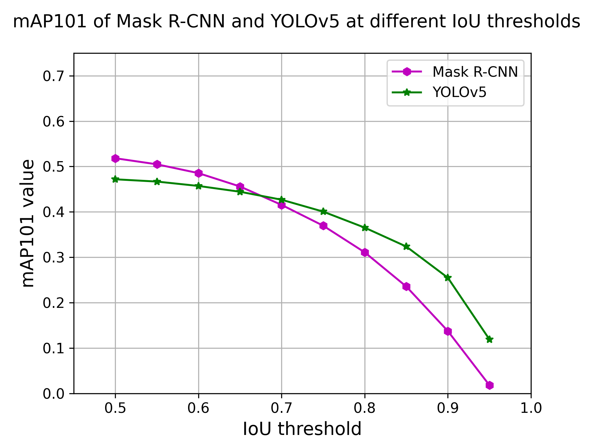
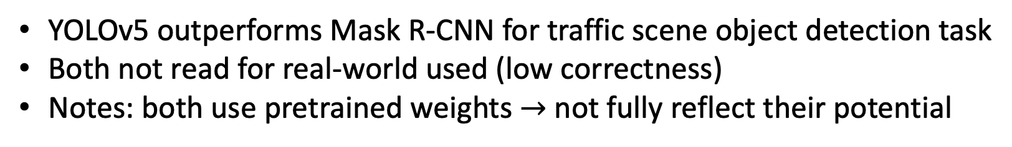
YOLOv5 outperforms Mask R-CNN for traffic scene object detection task
Both not read for real-world used (low correctness)
Notes: both use pretrained weights $→$ not fully reflect their potential
Result

Slide 28
Thank You

